Slide 1
Anaconda Navigator
Anaconda Navigator is a desktop graphical user interface (GUI) included in Anaconda® distribution that allows you to launch applications and easily manage conda packages, environments, and channels without using command-line commands. Navigator can search for packages on Anaconda Cloud or in a local Anaconda Repository. It is available for Windows, macOS, and Linux.
Why use Navigator?
In order to run, many scientific packages depend on specific versions of other packages. Data scientists often use multiple versions of many packages and use multiple environments to separate these different versions.
The command-line program conda is both a package manager and an environment manager. This helps data scientists ensure that each version of each package has all the dependencies it requires and works correctly.
Navigator is an easy, point-and-click way to work with packages and environments without needing to type conda commands in a terminal window. You can use it to find the packages you want, install them in an environment, run the packages, and update them – all inside Navigator.

Slide 2
Install Python
In this lesson, we will be using Python 3 with some of its most popular scientific libraries. Although one can install a plain-vanilla Python and all required libraries by hand, we recommend installing Anaconda, a Python distribution that comes with everything we need for the lesson. Detailed installation instructions for various operating systems can be found on The Carpentries template website for workshops and in Anaconda documentation.
MacOS
Open https://www.anaconda.com/products/individual#download-section with your web browser.
Download the Anaconda Installer with Python 3 for macOS (you can either use the Graphical or the Command Line Installer).
Install Python 3 by running the Anaconda Installer using all of the defaults for installation.
Windows
Open https://www.anaconda.com/products/individual#download-section with your web browser.
Download the Anaconda for Windows installer with Python 3. (If you are not sure which version to choose, you probably want the 64-bit Graphical Installer Anaconda3-...-Windows-x86_64.exe)
Install Python 3 by running the Anaconda Installer, using all of the defaults for installation except make sure to check Add Anaconda to my PATH environment variable.
Linux
You can download the binary files for your distribution from CRAN. Or you can use your package manager (e.g. for Debian/Ubuntu run sudo apt-get install r-base and for Fedora run sudo dnf install R). Also, please install the RStudio IDE.

Slide 3
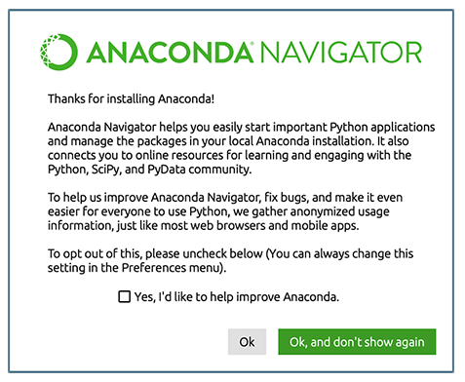
Anaconda Navigator
Launch Anaconda Navigator. It might ask you if you’d like to send anonymized usage information to Anaconda developers: Make your choice and click “Ok, and don’t show again” button.

Slide 4
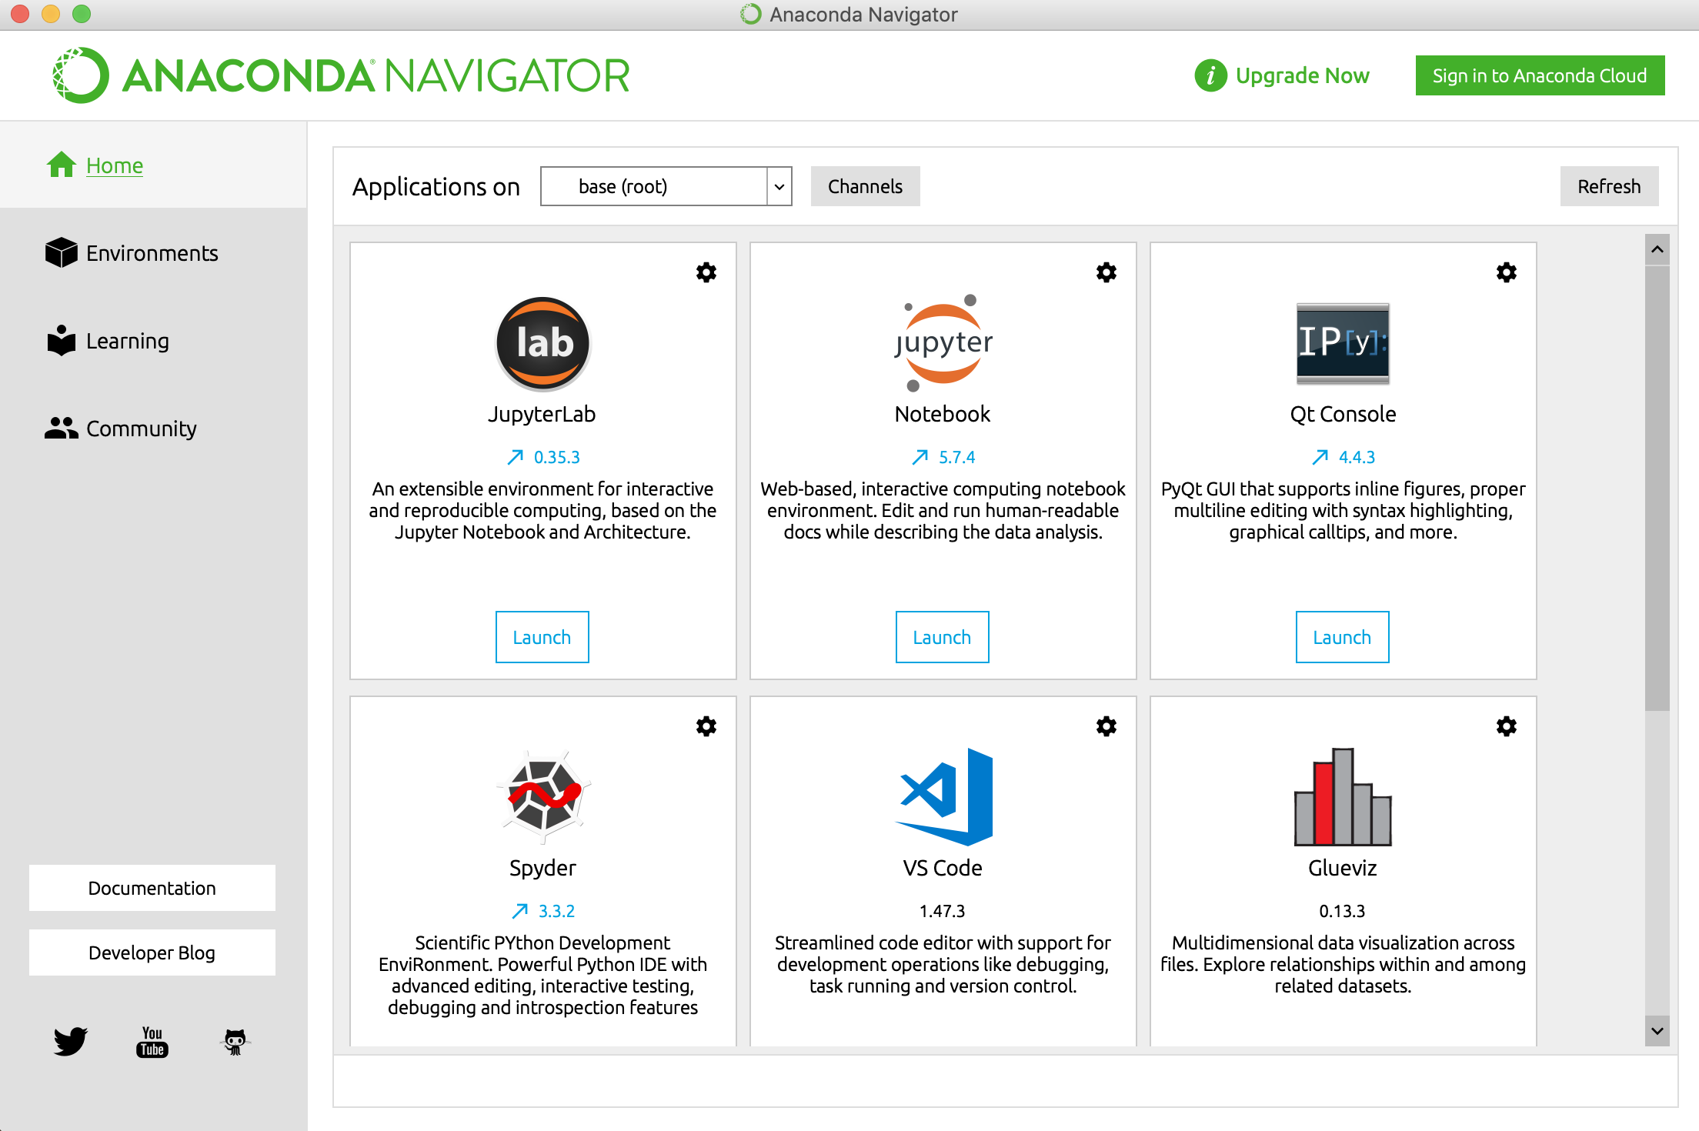
Install packages
On the Home page, click Environments.

Slide 5
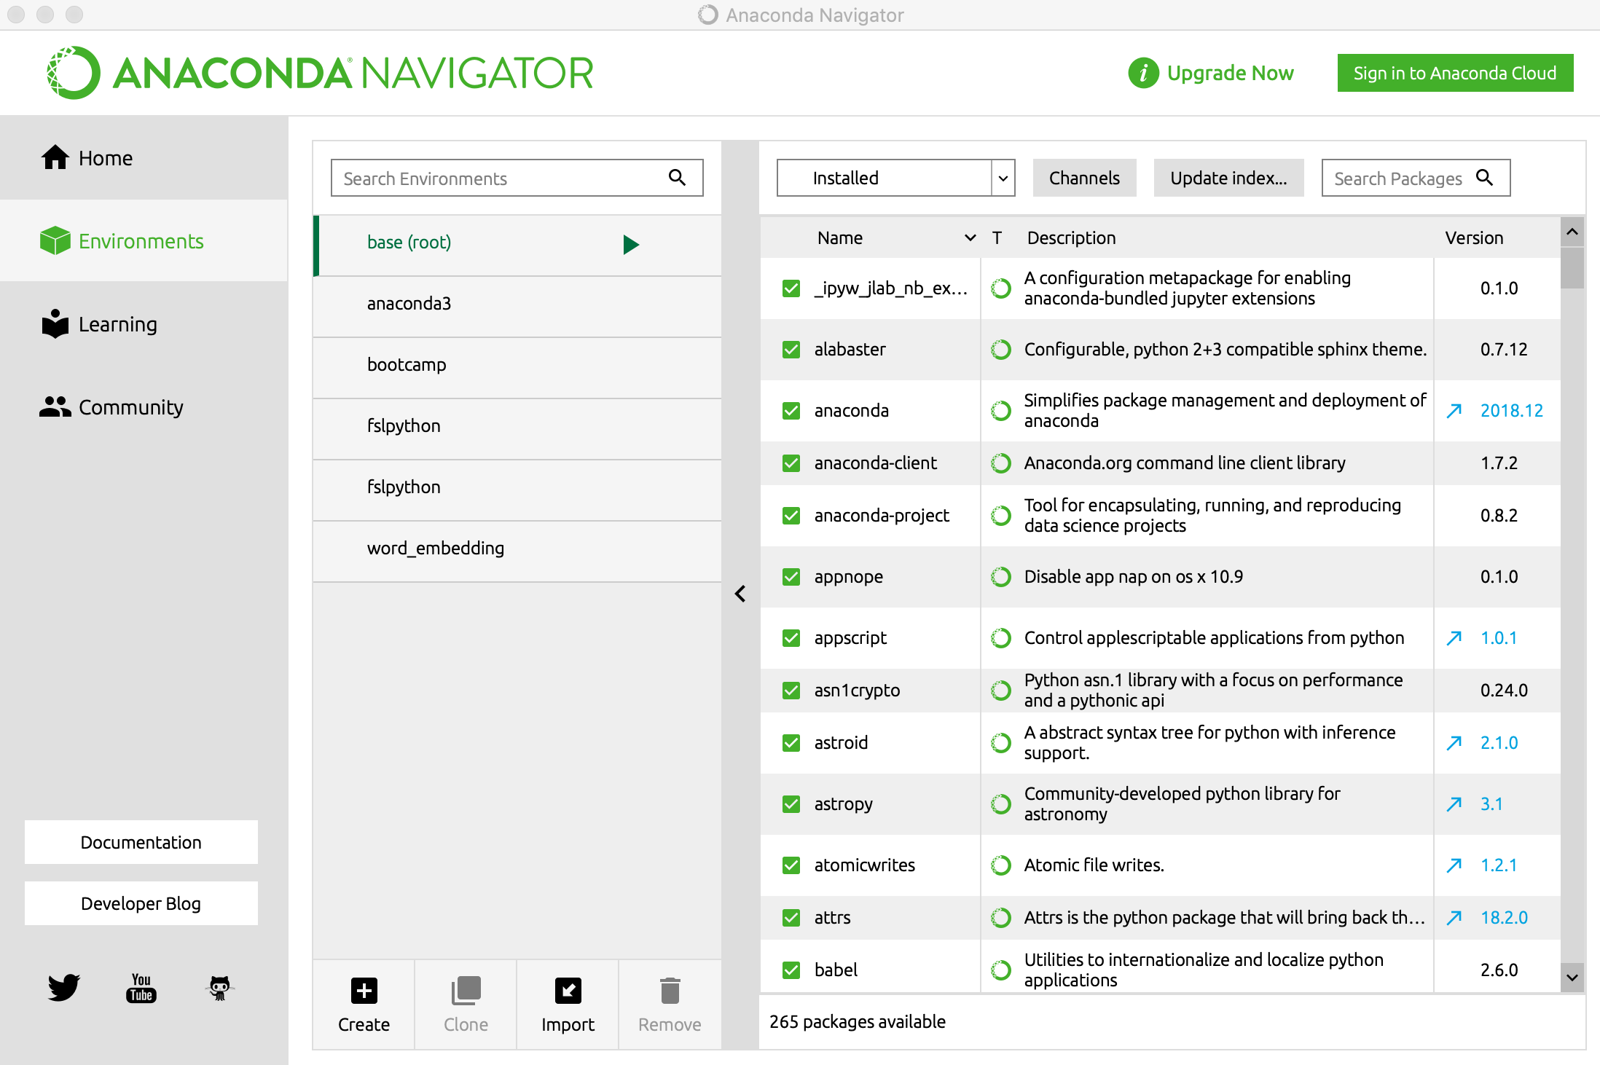
The Environments tab allows you to manage installed environments, packages, and channels.

Slide 6
The Environments tab allows you to manage installed environments, packages, and channels.
The left column lists your environments. Click an environment to activate it.
If you do not what to create an environment (yet), you can use `root`.

Slide 7
The Environments tab allows you to manage installed environments, packages, and channels.
The right column lists packages in the current environment.
The left column lists your environments. Click an environment to activate it.
If you do not what to specify an environment (yet), you can use `root`.

Slide 8
The default view is Installed packages. To change which packages are displayed, click the arrow next to the list, then select Not Installed, Upgradeable, or All packages. Change it to Not Installed.
The right column lists packages in the current environment.

Slide 9
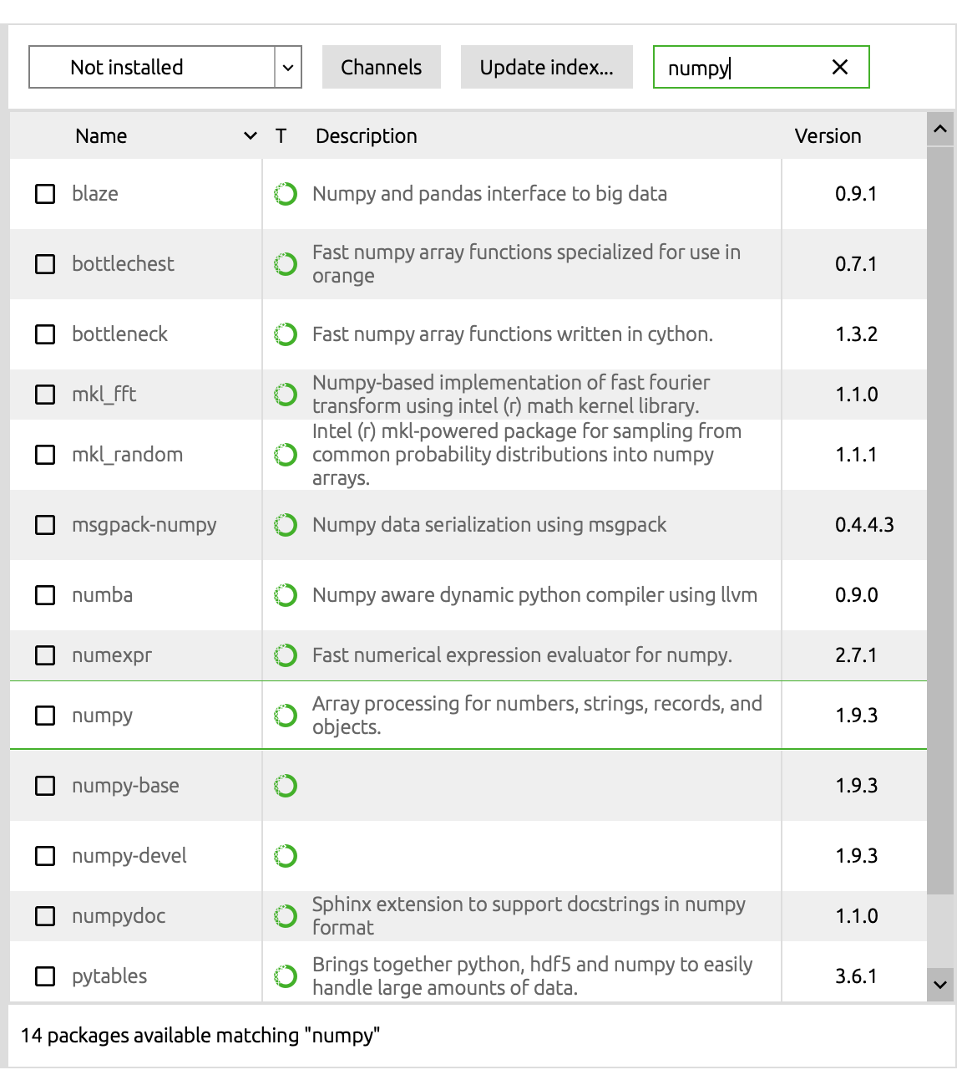
Say if you want to install a package called “numpy”
Change it to Not Installed.
The Environments tab allows you to manage installed environments, packages, and channels.
The left column lists your environments. Click an environment to activate it.
If you do not what to specify an environment (yet), you can use `root`.
Select the package you would like to install

Slide 10
The Environments tab allows you to manage installed environments, packages, and channels.
The left column lists your environments. Click an environment to activate it.
If you do not what to specify an environment (yet), you can use `root`.
Click “Apply” at the bottom

Slide 11
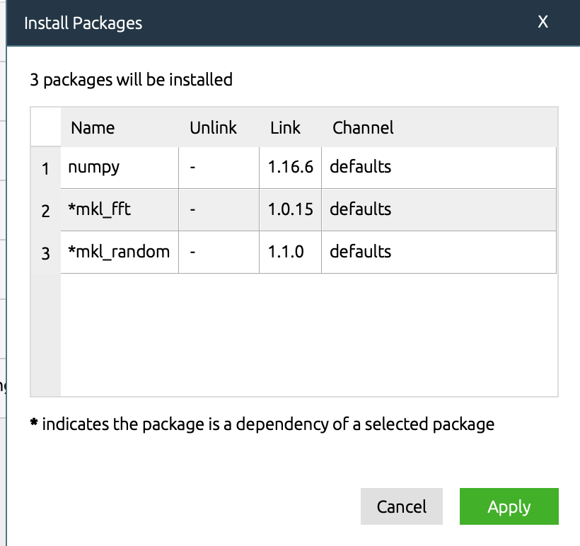
The Environments tab allows you to manage installed environments, packages, and channels.
The left column lists your environments. Click an environment to activate it.
If you do not what to specify an environment (yet), you can use `root`.
Click “Apply” again

Slide 12
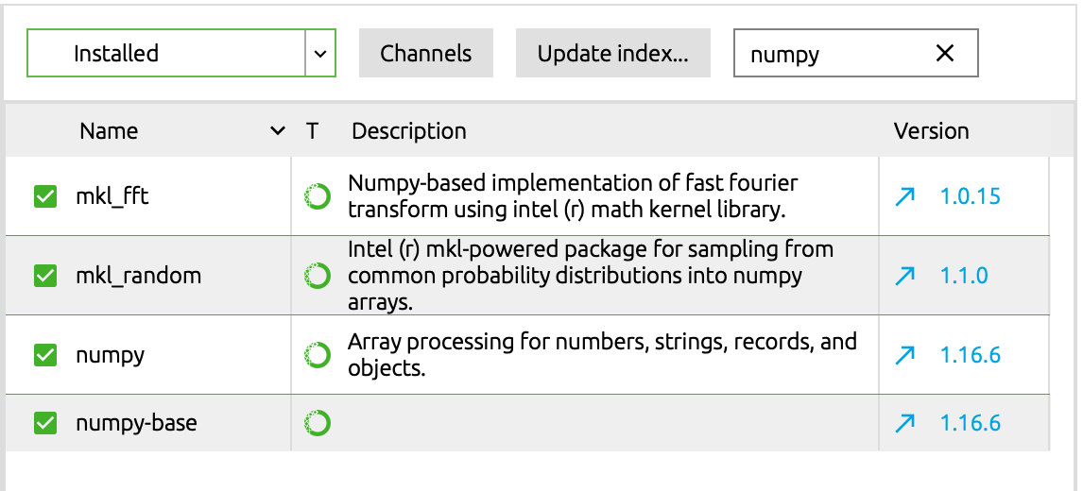
Once the package is installed, you can change it to Installed:
You should see the package you installed here:

Slide 13
Packages that you need to install before the bootcamp:
Numpy
Pandas
Statsmodels
Seaborn
Matplotlib

Slide 14
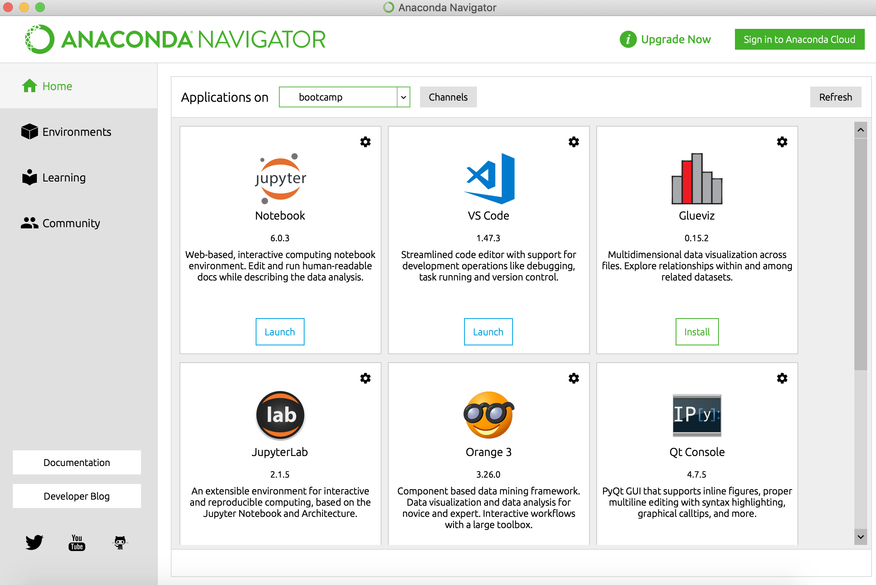
Launch Jupyter Notebook in Anaconda
This window show you which environment you are managing. Select the environment you would like to launch Jupyter Notebook (or you can select root: the environment that you have installed all the packages needed for the bootcamp)

Slide 15
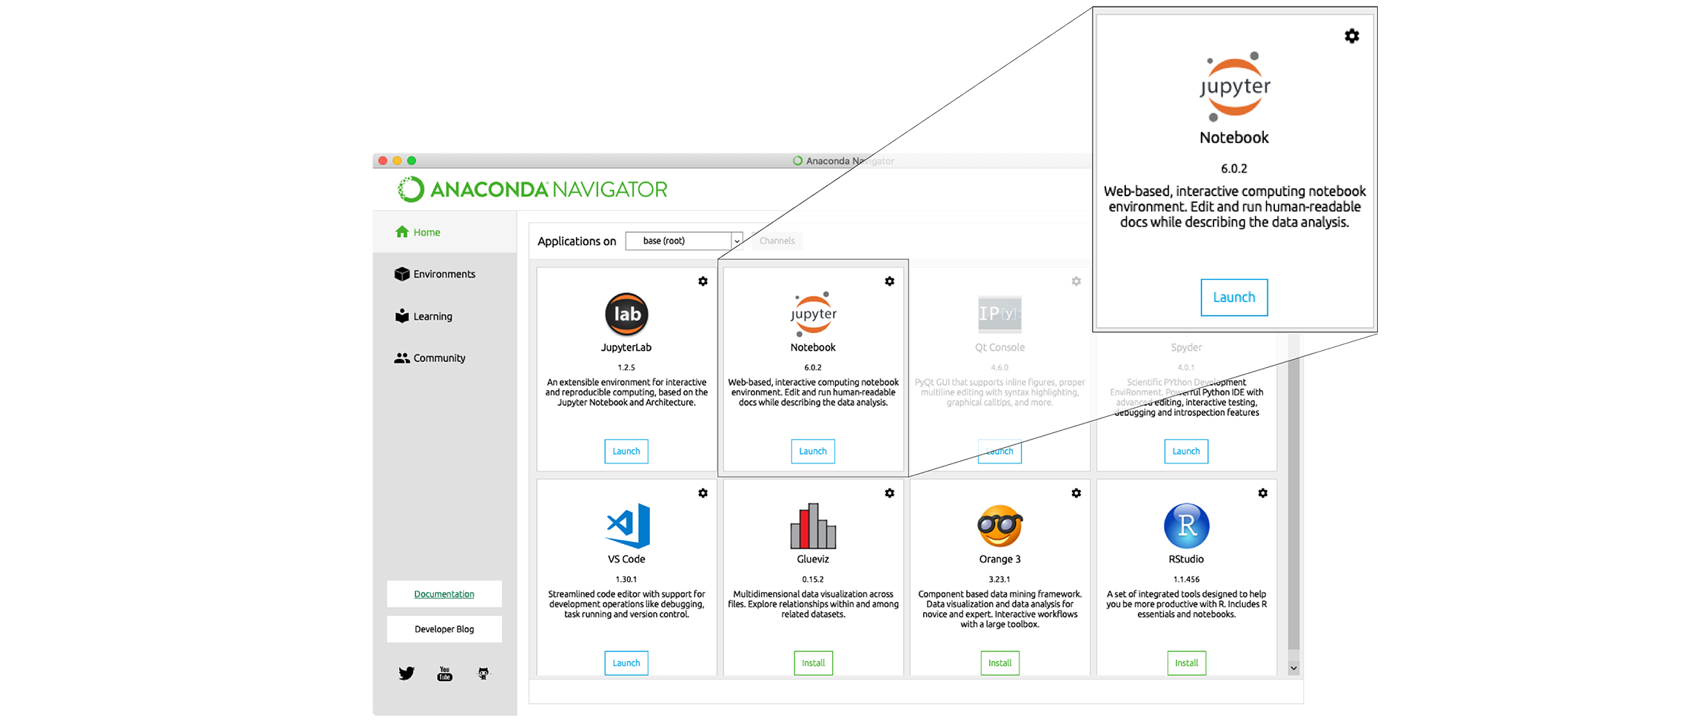
Find the “Notebook” tab and click on the “Launch” button: Anaconda will open a new browser window or tab with a Notebook Dashboard showing you the contents of your Home (or User) folder.
You may need

Slide 16
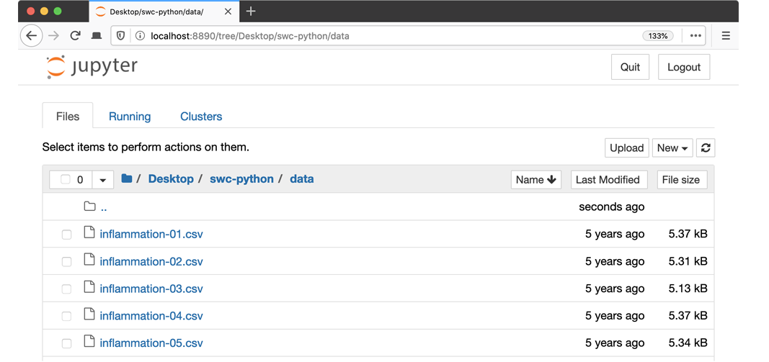
This is the Jupyter Notebook Dashboard. You can navigate to the folder where our modules live.

Slide 17
Information here is from
Software Carpentry website:
https://swcarpentry.github.io/python-novice-inflammation/setup/index.html
Anaconda Documentation:
https://docs.anaconda.com/anaconda/install/

